Slide 1
An Empirical Study of Chronic Diseases in the United States
A Visual Analytics Approach to Public Health

Slide 2
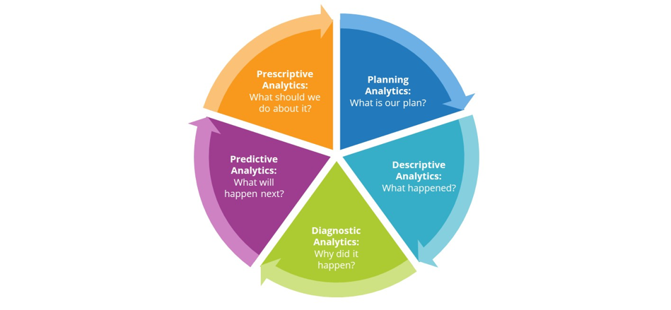
Abstract
This study explore the current state of chronic diseases in the USA, using data from the CDC, and applying visualization and descriptive analytics techniques.

Slide 3
Five main categories of variables are studied:
behavioral health
chronic disease
conditions
mental health
overarching conditions
Visual Analytics
demographics
correlations between variables in several categories.
Notes:
These are analyzed in the context of regions and states within the U.S. to discover possible correlations between variables in several categories.

Slide 4
There are widespread variations in the
prevalence of diverse chronic diseases,
number of hospitalizations for specific diseases,
and the diagnosis and mortality rates for different states.
developing insights that will help in the creation of targeted management, mitigation, and preventive policies
(-) risks and (-)costs of chronic diseases

Slide 5
chronic condition “is a physical or mental health condition that lasts more than one year and causes functional restrictions or requires ongoing monitoring or treatment”

Slide 6
Important
Chronic diseases are among the most prevalent and costly health conditions in the United States. (45% of all Americans suffer from at least one chronic disease) & highly affect QOL.
persistent conditions are the nation’s leading cause of death and disability. More than two thirds of all deaths are caused by one or more of these five chronic diseases: heart disease, cancer, stroke, chronic obstructive pulmonary disease, and diabetes.
major driver of health care costs, 75% of aggregate healthcare spending, or an estimated $5300 per person annually.

Slide 7
key elements of population health and chronic disease for success management
identifying those at risk.
having access to the right data about this population.
creating actionable insights about patients.
coaching them toward healthier choices.
Methods such as data-driven visual analytics help experts analyze large amounts of data and gain insights for making informed decisions regarding chronic diseases.

Slide 8
the vision for 21st century healthcare includes increased attention to cognitive support in decision making “Institute of Medicine and the National Research”

Slide 9
Visualization techniques offer cognitive support
offering mental models of the information through a visual interface.
Combine statistical methods and models with advanced interactive visualization methods to help mask the underlying complexity of large health data sets and make evidence-based decisions.
represent association between preventive measures and disease control.
Summary health dimensions across diverse patient populations.
timeline of disease prevalence across regions/populations

Slide 10
This paper
addresses the challenge of understanding large amounts of data related to chronic diseases by applying visual analytics techniques and producing descriptive analytics.
goal is to gain insight into the data and make policy recommendations.

Slide 11
Materials and Methods
conducting primarily descriptive analytics, to obtain a panoramic insight into the chronic diseases data set pulled from the CDC web site.
Then use visual analytics, aims to provide researchers and policymakers with better and more effective ways to understand and analyze large data sets, while also enabling them to act upon their findings in real time.

Slide 12
descriptive analytics
is a preliminary stage of data processing that creates a summary of historical data to yield useful information and possibly prepare the data for further analysis.
Data aggregation and data mining methods organize the data and make it possible to identify patterns and relationships.
Descriptive analytics is sometimes said to provide information about happened.
You might see, for example, an increase in Twitter followers after a particular tweet.
Notes:
Data aggregation is any process in which information is gathered and expressed in a summary form, for purposes such as statistical analysis. A common aggregation purpose is to get more information about particular groups based on specific variables such as age, profession, or income.
Data mining is the process of sorting through large data sets to identify patterns and establish relationships to solve problems through data analysis. Data mining tools allow enterprises to predict future trends.

Slide 13
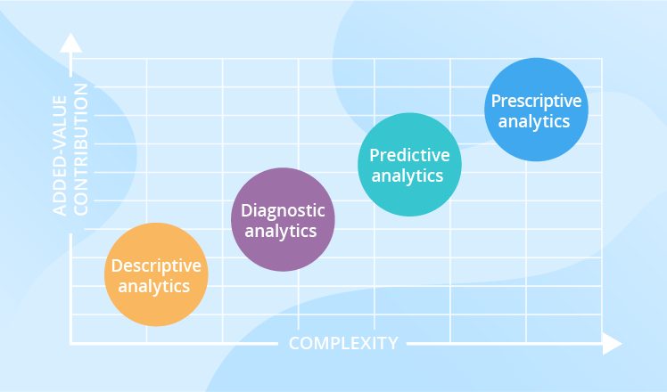
Here’s a summary of the stages of data analysis:
Descriptive analytics: What happened?
Diagnostic analytics: Why did it happen?
Predictive analytics: What could happen in the future?
Prescriptive analytics: How should we respond to those potential future events?
Notes:
Diagnostic analytics is a deeper look at data to attempt to understand the causes of events and behaviors. Predictive analytics, which is used to identify future probabilities and trends, is said provide information about what might happen in the future. Prescriptive analyticsis applied to try to identify the best outcome to events, given the parameters, and suggest decision options to best take advantage of a future opportunity or mitigate a future risk.

Slide 14
the most commonly used and most well understood type of analytics. It was the earliest to be introduced and the easiest by far to implement and understand in that it describes data “as is” without complex calculations.

Slide 15
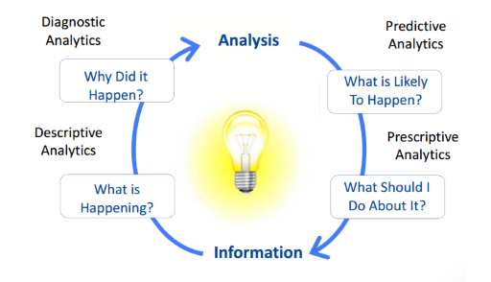

Slide 16
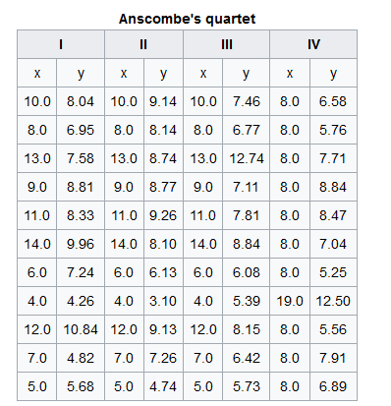
visual analytics
Why do we need visual analytics?
Would mathematical analytics be good enough?
Analyzing the four data pairs

Slide 17
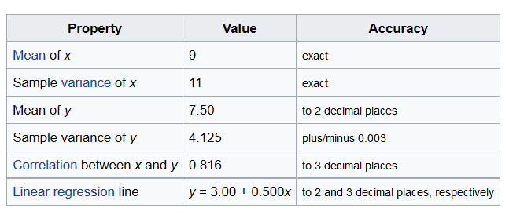
Finding?
How can you know more about these data sets?

Slide 18
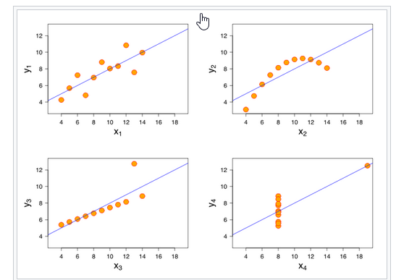
Are They the Same?

Slide 19
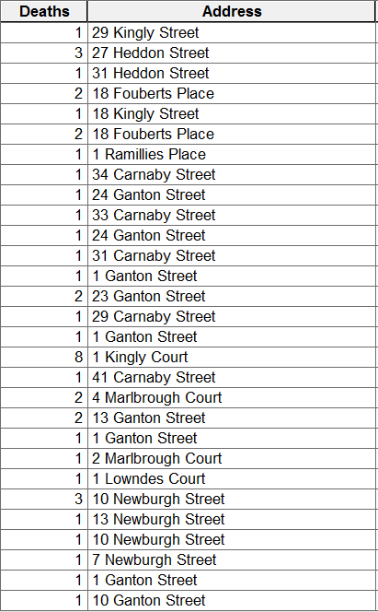
Another Example: John Snow Defeated Cholera.
What can you do with this table?

Slide 20
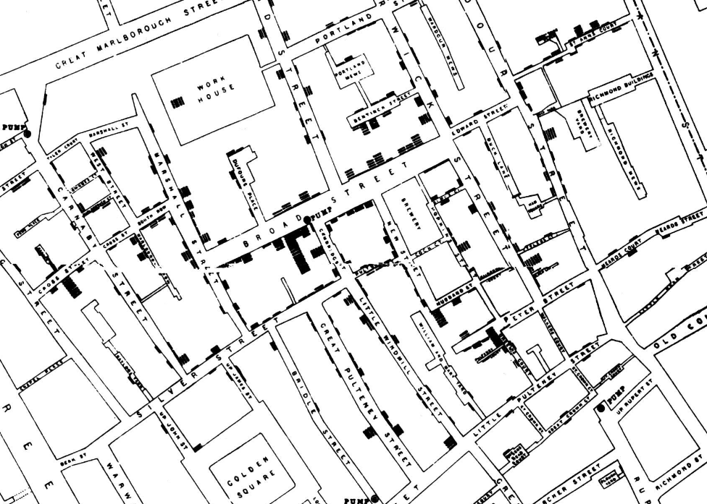

Slide 21
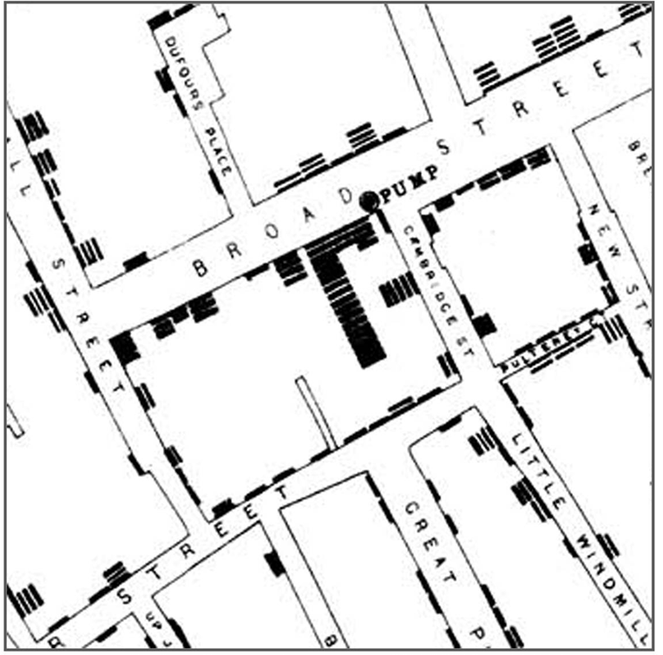

Slide 22
What is Visual Analytics?
“The science of analytical reasoning facilitated by interactive visual interfaces”, J. Thomas and K. Cook (eds.), 2005
More than information visualization or visual data mining, it involves technology to support all aspects of the analysis and reasoning processes.

Slide 23
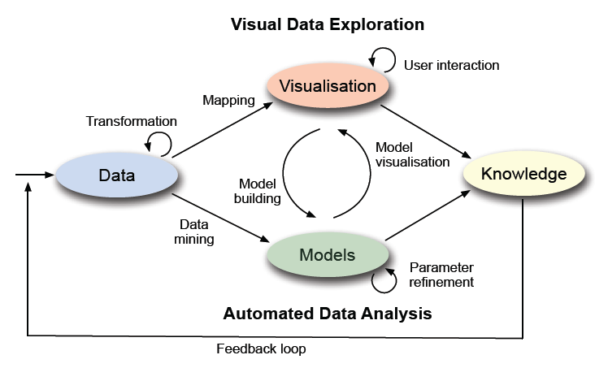
Data: death records
Model: simple aggregation based on address
Visualization: mapping aggregated numbers to map
Interaction: zooming in and out the map
Knowledge: death distribution is not random, centralized around an area, which has a well.

Slide 24
integrates the analytic capabilities of the computer and the abilities of human analysts, thus inviting novel discoveries and empowering individuals to take control of the analytical process.
Machine
Statistical Analysis Sematic-based
approach
Data Mining
Data Management
Compression & Filtering
Graphics & Rendering
Human
Human Cognition
Human-Centered Perception
Computing
Information
Design Visual intelligence
Decision Making
Theory
The Best of both sides
information visualization

Slide 25
interdisciplinary
Visual analytics applies such technology as business intelligence (BI) tools to combine human analytical skill with computing power.

Slide 26
Visualiza-tion
mining
Manage-ment
fusion
Statistics
cognitive
DATA

Slide 27
visual analytics research
confirmatory data analysis
using charts and other visual representations to present results)
exploratory data analysis
interacting with the data

Slide 28
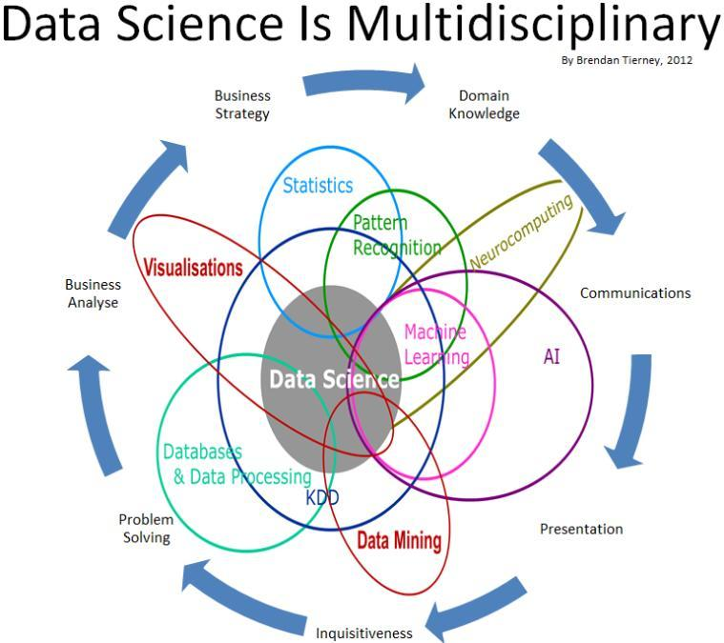

Slide 29
Back to our study
Most health data analyses start with descriptive analytics, using data to understand past and current health patterns and trends and to make informed decisions
charts and reports
categorize
characterize
Aggregate
classify
SQL
Notes:
The models in descriptive analytics categorize, characterize, aggregate, and classify
data, converting it into information for understanding and analyzing business decisions, outcomes,
and quality. Such data summaries can be in the form of meaningful charts and reports, and responses
to queries using SQL.

Slide 30
By using Descriptive analytics
How many patients with diabetes also have obesity?
Which of the chronic diseases are more prevalent in different regions of the country?
What behavioral habits are correlated to the chronic diseases?
Which groups of patients suffer from more than one chronic condition?
Is there an association between health insurance (and lack thereof) and chronic diseases?
What are cost trade-offs between chronic disease prevention and management?
What are typical patient profiles for various chronic diseases?

Slide 31
The CDC’s Division of Population Health offers a crosscutting set of 124 indicators that were developed by consensus.
Researchers downloaded secondary data for the United States from the CDC dataset, for the years 2012 to 2014.
including the 50 states and District of Columbia, Guam, Puerto Rico, and the U.S. Virgin Islands.

Slide 32
Data cleaning, integration, and transformation were conducted on the raw data set.
The main categories of variables included:
chronic condition.
mental health.
behavior habits.
preventative health,
demographics.
overarching conditions.
location.

Slide 33
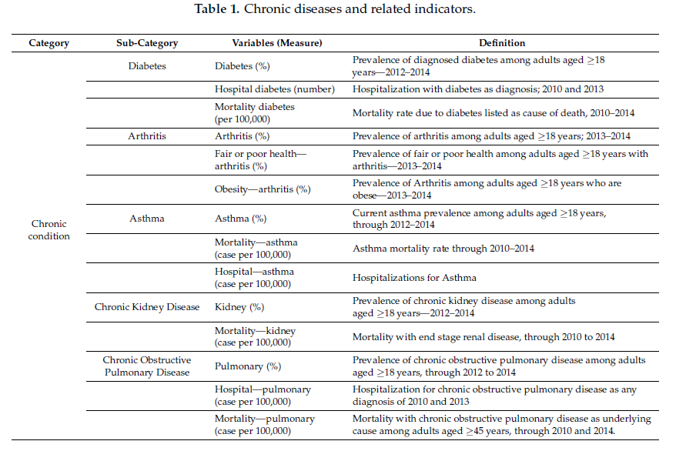

Slide 34
Results
Using visualization and descriptive analytics to explore the previous mentioned variables, with the objective of deciphering relationships and patterns that emerge from the visualization.
sample includes adults aged 18 years in the period 2012 to 2014.

Slide 35
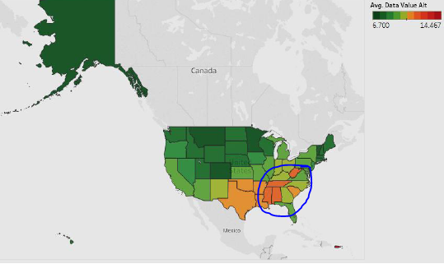
Figure 1 models the average prevalence of diagnosed diabetes Puerto Rico leads the pack, followed by Mississippi.

Slide 36
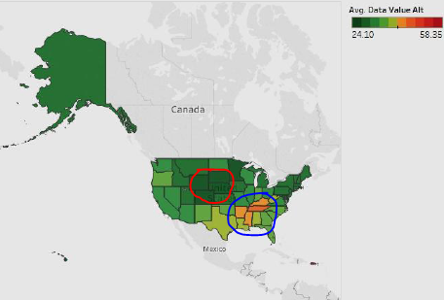
As Figure 2 shows, Puerto Rico has the highest number of citizens in fair or poor health with arthritis. Puerto Rico is followed by Tennessee and Mississippi.

Slide 37
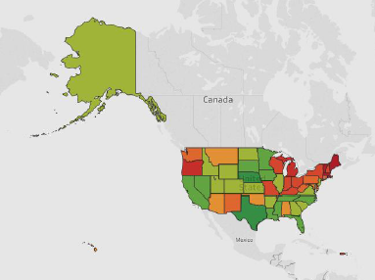
The current asthma prevalence among adults aged 18 years for the period 2012 to 2014 is indicated in Figure 3. West Virginia has a higher prevalence

Slide 38
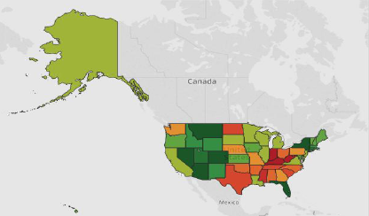

With regard to end-stage renal disease, Figure 4 shows that the condition is dispersed widely among various areas.

Slide 39
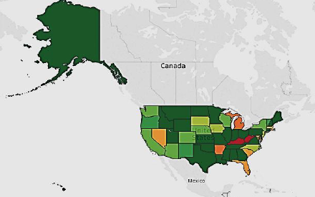
Figure 5 The average value for hospitalization for chronic obstructive pulmonary disease.
Kentucky and West Virginia have higher hospitalizations compared to other states. Most of the areas are below 45 cases per 100,000.

